Slide 1


Project Name: iCare Health Monitoring and User-Information
Team Members: Vignesh.S
BarathJayan D
Anantha krishnan VS
Sairam BR

Slide 2
Introduction
Present innovation deals with the design of a flexible antenna with nickel particle-based flexible nickel aluminate (NiAl2O4) as a substrate material in order to estimate the glucose content of the blood by evaluating the conductivity and relative permittivity properties.
Emerging technologies like ASP.NET Web API and JavaScript frameworks like AngularJS makes it easy to design and build Single Page Applications (SPAs) web sites using ASP.NET Web API and the popular client-side JavaScript library called AngularJS. The idea behind this series is learning various components of the Angular JS library and making developers comfortable in AngularJS. We will do some hands-on with the Angular JS library by building an iCare Health Monitoring and User Information throughout this series

Slide 3
Development of your techstack Web Application Microservice
Microservice is a single-page web application designed to control the process ofzcollecting and processing data to monitor the health condition of the patient.
BUILD WITH
ASP.NET Core 3.1
Microservices
Clean architecture
CRUD
REST API
Docker
Entity Framework
Automapper
Health check
xUnit
Moq
Serilog
MassTransit
RabbitMQ
Open Tracing
Jaeger
Angular 9
Sensor service
Sensor microservice is designed to manage and store information about telemetry sensors and patient health data, collected by sensors.
Data Processor Service
Data Processor microservice is designed to process data received from substrate-based flexible antenna in the 2.4 GHz.
Identity Service
Identity microservice is designed to control access to application resources.
Profile Service
Profile microservice is designed to manage and store user profiles.
Report Service
Report microservice is designed to manage and store patient health reports, received from Data Processor microservice
API Gateway
Sensor Microservice
DataProcessorMicroservice
Identity Microservice
Profile Microservice
Report Microservice
Event Bus
Data Source
Web App

Slide 4
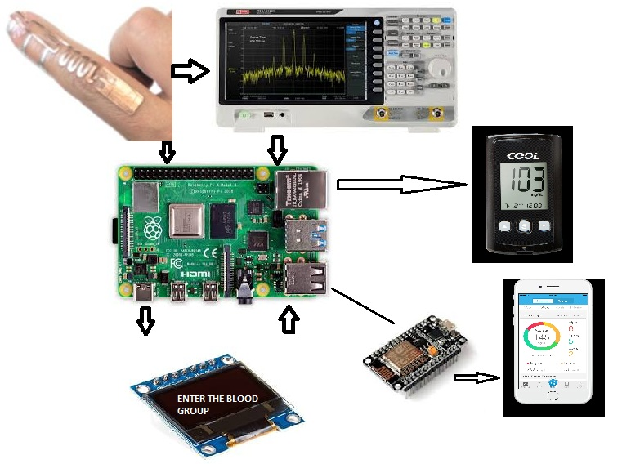
WORKING
Our basic idea is to design PIFA antenna using CST software and thereby fabricating the antenna with one port and identifying its reflection parameters and VSWR ratio.And some electronic component are used.
depicts the process flow of Non-Invasive Blood Gulucometer in which the flexible antenna can be place in the hands of a person and the antenna emits a RF signal of 2.4GHz. Depending upon the received signal power the amount of glucose content in Blood can be measured.
ARDUINO
RASPBERRY PI
NODEMCU
LCD DISPLAY

Slide 5
MECHANISUM
Dielectric constant, ∈' = C_{s} / C_{a} = (C_{s}' – C_{L}) / (C_{a}' – C_{L}) where, C_{s} = Actual sample capacitance
C_{l} = Lead capacitance
C_{a} = Actual air capacitance
C_{s}' = Measured capacitance of cell with liquid
C_{a}'= Measured capacitance of cell without liquid, at 1 KHz
frequency
Dielectric loss, ∈'' = (1.8 x 1012 k) / ν
where, ν = Frequency; k = electrical Conductivity
Conductivity, k = GL / A
where G = Conductance;
L = Distance between the plates of the cell
A = Area of the plates
Blood GroupC | Parameter | Whole Blood | Plasma
Group A | Dielectric Constant, ε’ | 73.55 x 10³ | 138.04 x 10³
 | Dielectric Loss, ε” | 222.70 x 10⁷ | 322 x 10⁷
 | Conductivity, K (mho-cm⁻¹) | 1.230 | 1.81
Group B | Dielectric Constant, ε’ | 76.12 x 10³ | 138.31 x 10³
 | Dielectric Loss, ε” | 21.6 x 10⁷ | 318 x 10⁷
 | Conductivity, K (mho-cm⁻¹) | 1.12 | 1.77
Group AB | Dielectric Constant, ε’ | 51.74 x 10³ | 137.81 x 10³
 | Dielectric Loss, ε” | 186.6 x 10⁷ | 324 x 10⁷
 | Conductivity, K (mho-cm⁻¹) | 1.04 | 1.81
Group O | Dielectric Constant, ε’ | 70.65 x 10³ | 148.16 x 10³
 | Dielectric Loss, ε” | 216 x 10⁷ | 322.2 x 10⁷
 | Conductivity, K (mho-cm⁻¹) | 1.2 | 1.8
Type of Tissue | ε∞ | Δ ε1 | τ1(ps) | Δε2 | τ2 (ns) | Δε3 | τ3 (μs)
Blood | 4.0 | 56 | 8. 38 | 5200 | 132.63 | 0.0 | 0.00
Fat | 2.5 | 9 | 7.96 | 35 | 15.92 | 3.3 x 10⁴ | 159.15
Muscle | 4.0 | 50 | 7.23 | 7000 | 353.68 | 1.2 x 10⁶ | 318.31
Skin (Wet) | 4.0 | 32 | 7.23 | 1100 | 32.48 | 0.0 | 0.00
Skin (Dry) | 4.0 | 39 | 7.96 | 280 | 79.58 | 3.0 x 10⁴ | 1.59

Slide 6
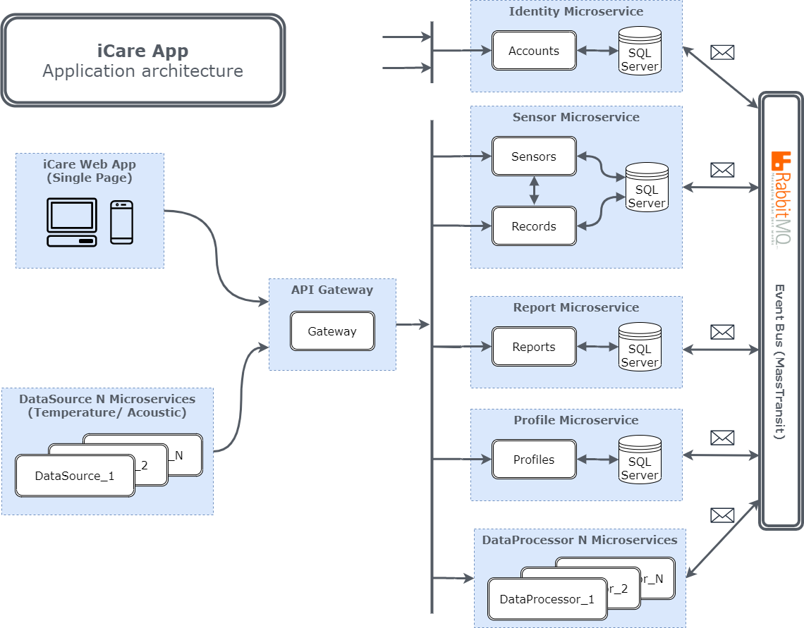
SYSTEM DESIGN

Slide 7
SYSTEM IMPLIMENTATION
API Gateway
API Gateway is a single-entry point for a microservice application. This service routes to the designated microservice.In addition, each microservice has an external port and can be accessed from outside.
Microservice | Container name | Port
SQL Server | sqldata | 1433:80
Gateway.API | gateway.api | 3000:80
Sensor.API | sensor.api | 3001:80
Report.API | report.api | 3002:80
Profile.API | profile.api | 3003:80
Identity.API | identity.api | 3004:80
DataProcessor.API | dataprocessor_1.api | 3005:80
DataProcessor.API | dataprocessor_2.api | 3006:80

Slide 8
Future scope
Health care is moving into the home increasingly often and involving a mixture of people, a variety of tasks, and a broad diversity of devices and technologies; it is also occurring in a range of residential environments. The factors driving this migration include the rising costs of providing health care; the growing numbers of older adults; the increasing prevalence of chronic disease; improved survival rates of various diseases, injuries, and other conditions (including those of fragile newborns); large numbers of veterans returning from war with serious injuries; and a wide range of technological innovations. The health care that results varies considerably in its safety, effectiveness, and efficiency, as well as its quality and cost.
The committee was charged with examining this major trend in health care delivery and resulting challenges from only one of many perspectives: the study of human factors. From the outset it was clear that the dramatic and evolving change in health care practice and policies presents a broad array of opportunities and problems. Consequently the committee endeavored to maintain focus specifically on how using the human factors approach can provide solutions that support maximizing the safety and quality of health care delivered in the home while empowering both care recipients and caregivers in the effort.

Slide 9
Market Viability
This Product Can be sell in the market with two types of Prospective
In india There was More than 77% of People using the using smartphones and this was Increased by 15% from 2019 it shows people will to buy the smart devices
Commercial
Medical Equipment
User friendly Smart device
Affordable for Everyone
Both Young and Old Generation people can easy access
Capability with all smartphones
Totally making in India the cost will be very less compared with existing competitor's device

Slide 10
How our “app” makes India Atmanirbhar
In our day today life, people are not taking care of their health. Due to that create a lack of glucose in our body. Lower the glucose levels can also cause a variety of problems within your central nervous system.
Early symptoms include weakness, lightheadedness, and dizziness. Headaches can occur from a lack of glucose, especially if you have diabetes. You may also feel signs of stress, such as nervousness, anxiety, and irritability.so by using our mechanism everyone can able to check the level of glucose automatically with very low cost.
The device which build is keep on monitor the person in every single seconds. we can control the level and take care of our health.

Slide 11
THANK YOU!

